Slide 1
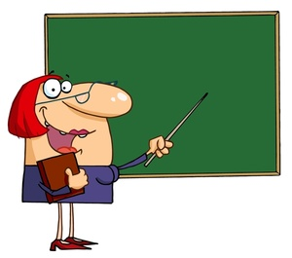
SYLLABLE TYPES
OPEN SYLLABLES
By Debbie Rickards

Slide 2
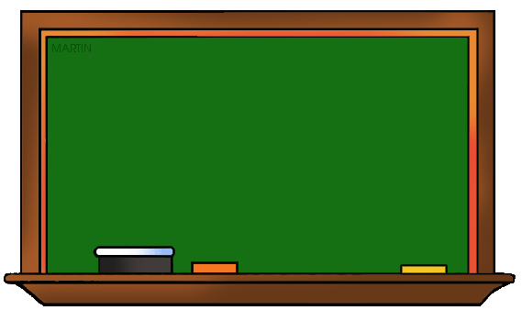
OPEN SYLLABLES
An open syllable is a syllable that ends with a single vowel. The vowel is usually long, and the letter y acts as a long vowel.

Slide 3
OPEN SYLLABLES
hi
go
me
my
sky

Slide 4
OPEN SYLLABLES
try
be
she
no
so

Slide 5
OPEN & CLOSED SYLLABLES
si lent
silent

Slide 6
OPEN & CLOSED SYLLABLES
bla zing
blazing

Slide 7
OPEN & CLOSED SYLLABLES
li lac
lilac

Slide 8
OPEN & CLOSED SYLLABLES
mo ment
moment

Slide 9
OPEN & CLOSED SYLLABLES
ba con
bacon

Slide 10
OPEN & CLOSED SYLLABLES
la bel
label

Slide 11
OPEN & CLOSED SYLLABLES
e go
ego

Slide 12
OPEN & CLOSED SYLLABLES
i tem
item

Slide 13
OPEN & CLOSED SYLLABLES
ho tel
hotel

Slide 14
OPEN & CLOSED SYLLABLES
mi nus
minus

Slide 15
OPEN & CLOSED SYLLABLES
hu man
human

Slide 16
OPEN & CLOSED SYLLABLES
e vent
event

Slide 17
OPEN & CLOSED SYLLABLES
fre quent
frequent

Slide 18
OPEN & CLOSED SYLLABLES
slo gan
slogan

Slide 19
OPEN & CLOSED SYLLABLES
to tal
total

Slide 20
OPEN & CLOSED SYLLABLES
pi lot
pilot

Slide 21
OPEN & CLOSED SYLLABLES
ro bot
robot

Slide 22
OPEN & CLOSED SYLLABLES
o pen
open

Slide 23
OPEN & CLOSED SYLLABLES
be gin
begin

Slide 24
OPEN & CLOSED SYLLABLES
mo tel
motel

Slide 25
OPEN & CLOSED SYLLABLES
o pen ing
opening

Slide 26
OPEN & CLOSED SYLLABLES
e vent ful
eventful

Slide 27
OPEN & CLOSED SYLLABLES
be gin ning
beginning

