Slide 1
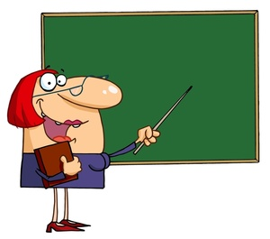
SYLLABLE TYPES
Closed & VCe Multi-Syllable Words
By Debbie Rickards

Slide 2
MULTI-SYLLABLE WORDS
con cave
concave

Slide 3
MULTI-SYLLABLE WORDS
ig nite
ignite

Slide 4
MULTI-SYLLABLE WORDS
lime stone
limestone

Slide 5
MULTI-SYLLABLE WORDS
con tem plate
contemplate

Slide 6
MULTI-SYLLABLE WORDS
cas cade
cascade

Slide 7
MULTI-SYLLABLE WORDS
ill us trate
illustrate

Slide 8
MULTI-SYLLABLE WORDS
con fis cate
confiscate

Slide 9
MULTI-SYLLABLE WORDS
back stroke
backstroke

Slide 10
MULTI-SYLLABLE WORDS
hem line
hemline

Slide 11
MULTI-SYLLABLE WORDS
com bine
combine

Slide 12
MULTI-SYLLABLE WORDS
con crete
concrete

Slide 13
MULTI-SYLLABLE WORDS
com mune
commune

Slide 14
MULTI-SYLLABLE WORDS
com pute
compute

Slide 15
MULTI-SYLLABLE WORDS
com plete
complete

Slide 16
MULTI-SYLLABLE WORDS
ded ic ate
dedicate

Slide 17
MULTI-SYLLABLE WORDS
in clude
include

Slide 18
MULTI-SYLLABLE WORDS
ob lig ate
obligate

Slide 19
MULTI-SYLLABLE WORDS
be came
became

Slide 20
MULTI-SYLLABLE WORDS
dis place ment
displacement

Slide 21
MULTI-SYLLABLE WORDS
con fine
confine

Slide 22
MULTI-SYLLABLE WORDS
com pen sate
compensate

Slide 23
MULTI-SYLLABLE WORDS
min im ize
minimize

Slide 24
MULTI-SYLLABLE WORDS
in com plete
incomplete

Slide 25
MULTI-SYLLABLE WORDS
bap tize
baptize

Slide 26
MULTI-SYLLABLE WORDS
fas cin ate
fascinate

Slide 27
MULTI-SYLLABLE WORDS
frus trate
frustrate

Slide 28
MULTI-SYLLABLE WORDS
dis ad van tage
disadvantage

